Slide 1
E-Nursery
Mini project presentation

Slide 2
Team Members:
1] Sayli Milind Jawale(94)
2] Zainab Nazimuddin Kazi(138)
Project Guide:
Prof.Pramodini Dange

Slide 3
Introduction :-
E–Nursary web application consist purchasing and selling products which is intended to benefit both gardeners and users.
This is a unique place for nature enthusiasts to browse & order the best quality of plants online and get them delivered
The E-Nursary is an online nursery that allows you to shop for plants from the comfort and convenience of your homes.
In this system there are two users Admin and Customer. The admin can view, add, delete, and update flowering plants detail.
Customer can view the plants and their details and add it to their cart or keep it in their wishlist. Customer can view their cart and make payments.

Slide 4
Existing System :
The manual processing is quite time consuming, less accurate in comparison processing.
It is very slow in processing data.
It is very difficult to create manual working.
It is time Consuming & having Lot of Paper work.
Much time and energy are wasted.
Proposed System:
This is a unique place for nature enthusiasts to browse & order the best quality of plants online and get them delivered.
This would give convenience to a shopper, along with instant satisfaction, for the purchase of a variety of products.

Slide 5
Scope :
Number of shopkeeper’s can register to the web portal for increase their sale.
This application can be used by any user to purchase the online plants and get appropriate information by viewing short summery about the plant’s items through videos.
If any changes to make customer can purchase the plants through different payment schemes like debit card, credit card, pat, phone pay, cash on delivery etc.

Slide 6
Technology Used :
Front-End languages:
1.HTML
2.CSS and Bootstrap
3.Javascript
Back-End languages:
1.Python
2.SQLite

Slide 7
List of Modules :
Medicinal plants
Registration
Outdoor plants
Indoor plants
Order
Admin

Slide 8
Functional Requirement :
Inventory tracking
Order tracking
Friendly search engine
Quick by feature
Technical details
Non -Functional Requirement :
1)Security
2)Storage
3)Performance
4)Attractive Design
5)Reliablity

Slide 9
Advantages :
Customers can get their plants delivered instead of physically visiting nurseries.
Enables nurseries to automate selling plants online.
Allows Nurseries to accept online payments.
User can add plants they like to their wish list.

Slide 10
Content:
Analysis and Design
• Analysis Phase
1] Class Diagram
2] Use case Diagrams
• Design phase
1] Sequence Diagram
2] Collaboration Diagram
3] Activity Diagram
4] State chart Diagram
• Web site map diagram
• ERD
• Modules Specification
• User interface

Slide 11
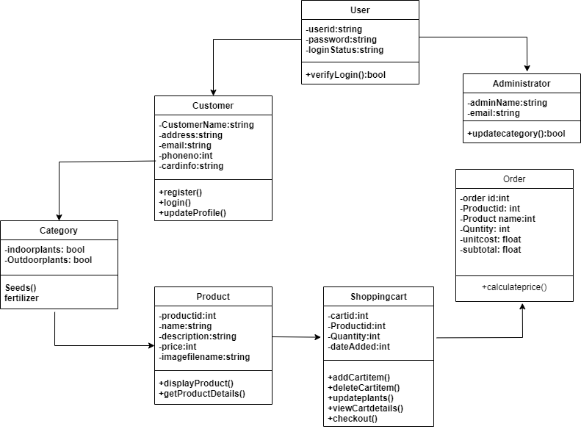
• Analysis Phase
1]Class Diagram:

Slide 12
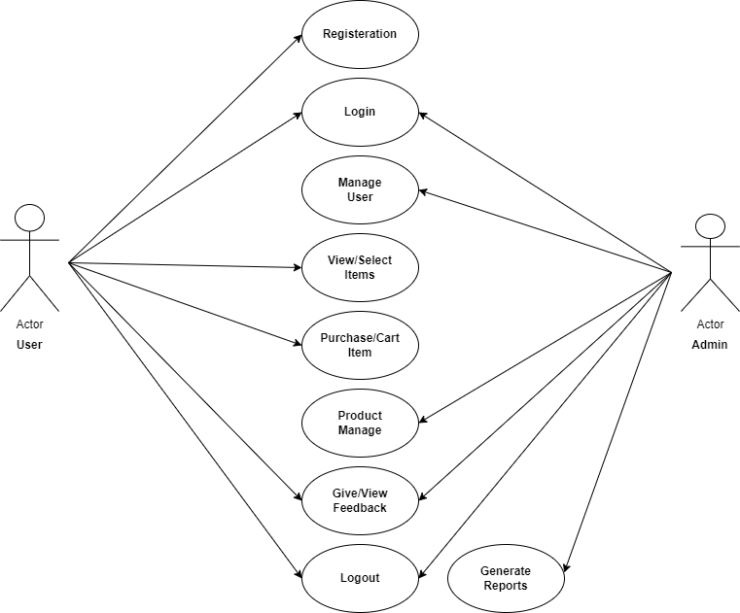
Registration
2] Use Case Diagram:

Slide 13
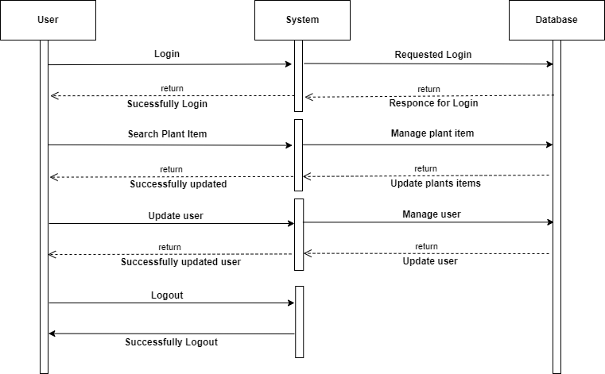
• Design phase
1]Sequence diagram:

Slide 14
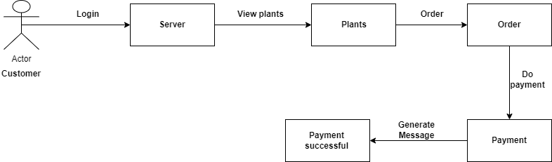
2] Collaboration diagram:

Slide 15
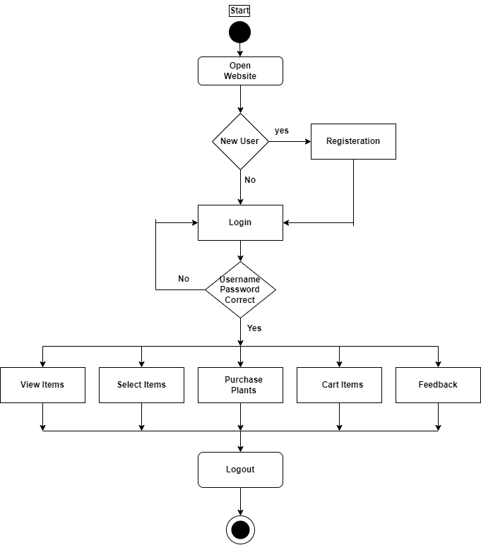
3] Activity Diagram:
Registration

Slide 16
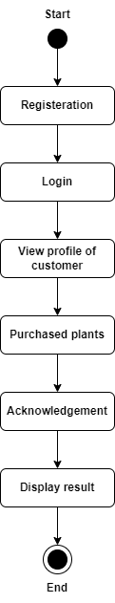
4] State Chart Diagram:
Registration

Slide 17
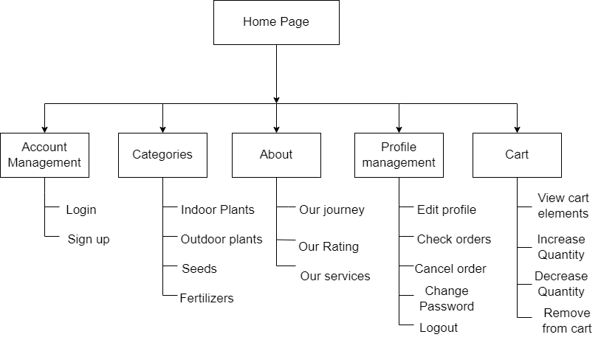
• Web site map diagram

Slide 18
ERD(Entity relationship Diagram):
User
username
password
first_name
Product
title | CharField
selling_price | FloatField
discounted_price | FloatField
description | TextField
brand | CharField
category | CharField
product_image | ImageField
Customer
user | ForeignKey
name | CharField
locality | CharField
city | CharField
zipcode | IntegerField
state | CharField
m2o
m2o
m2o
m2o
m2o
orderplaced
user | ForeignKey
customer | ForeignKey
product | ForeignKey
quantity | PositiveIntegerField
ordered_date | DateTimeField
status | CharField
m2o
Cart
user | ForeignKey
product | ForeignKey
quantity | PositiveIntegerField

Slide 19
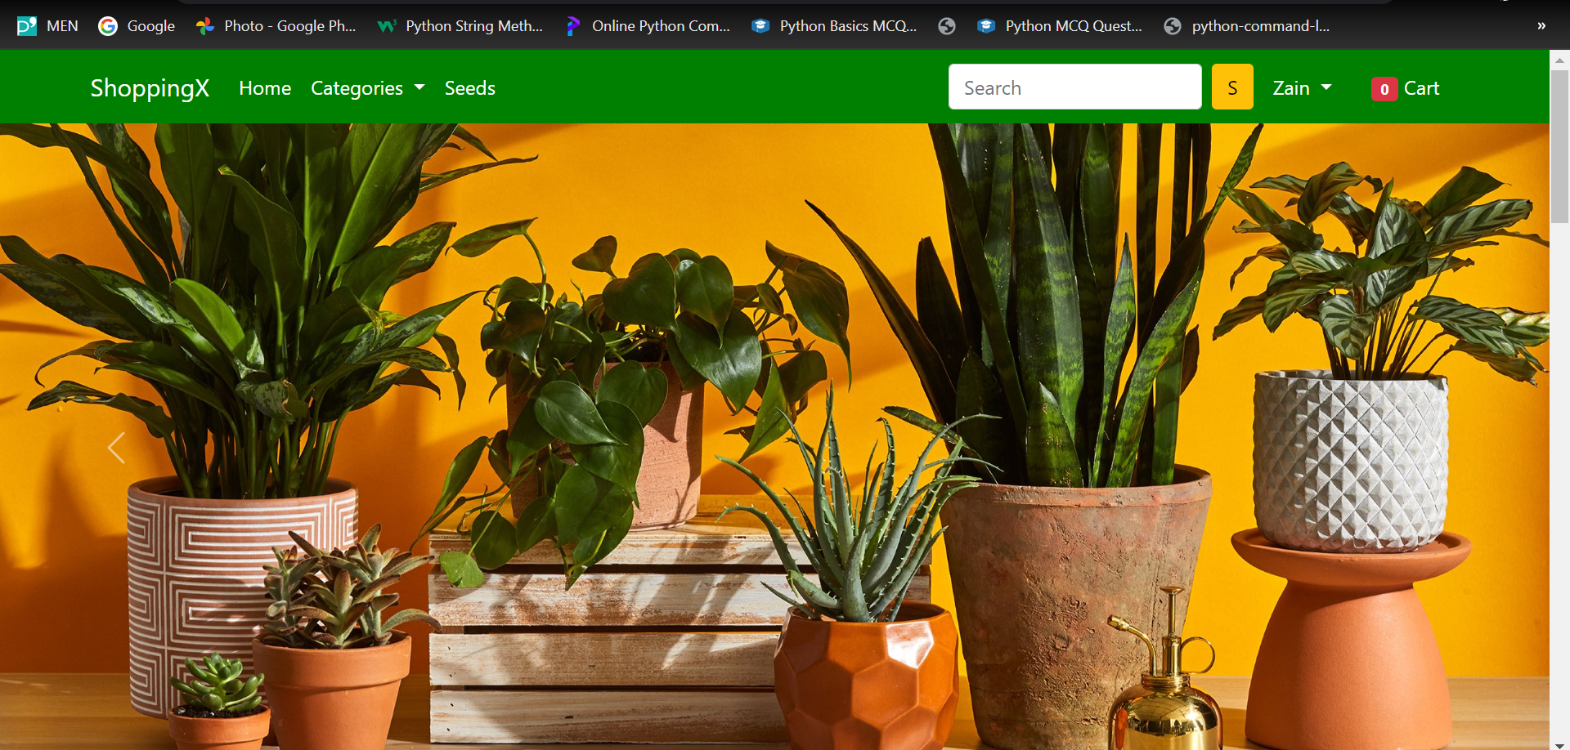
Home page:

Slide 20
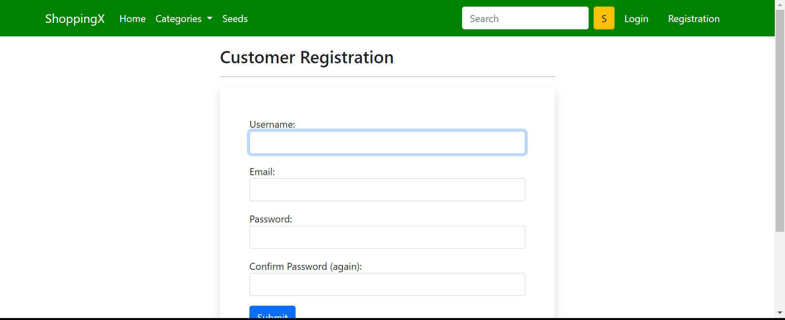
Registration Page:

Slide 21
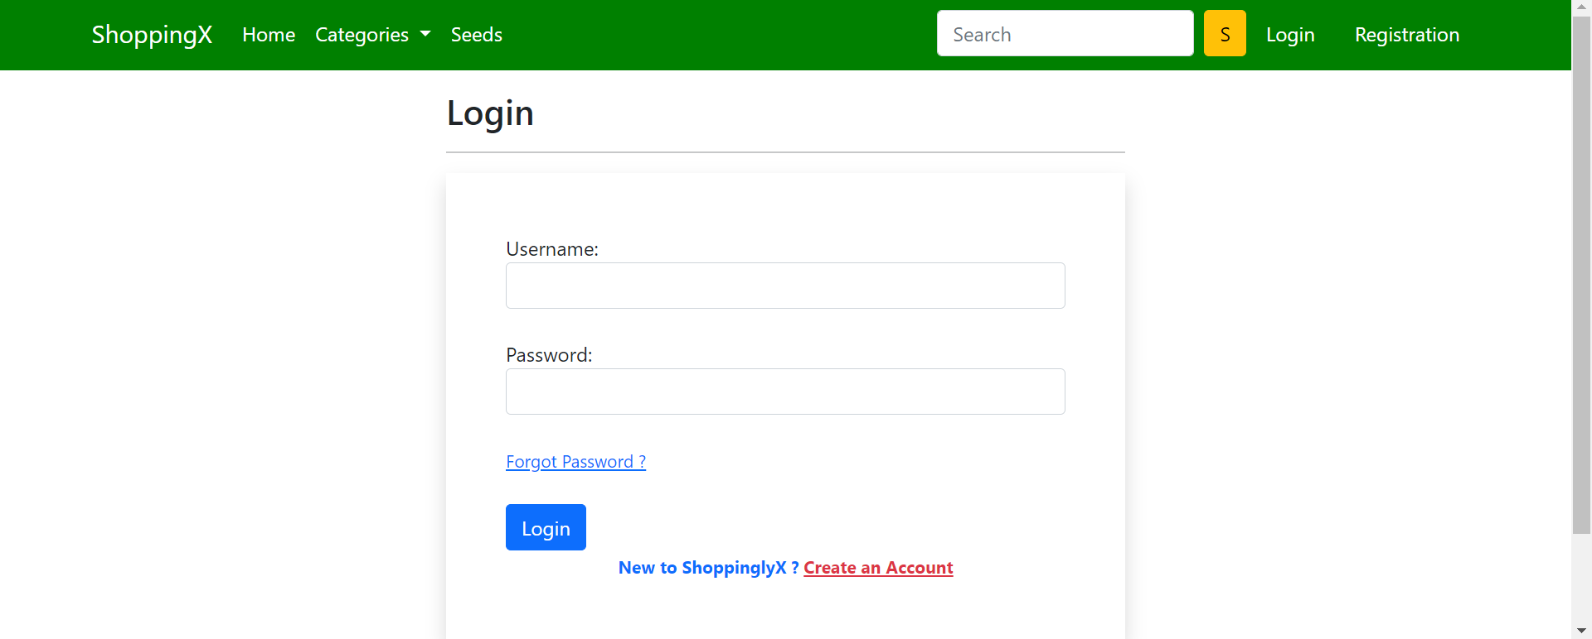
Login page:

Slide 22


